Slide 1

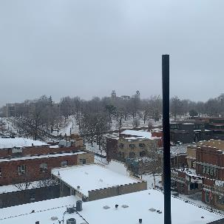
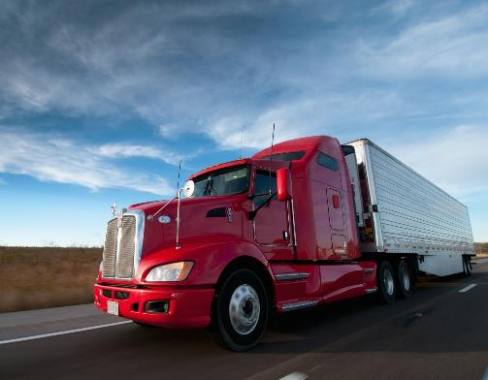

Asset Tracking with the Helium Network
Team RazorBlocks

Slide 2
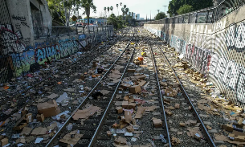
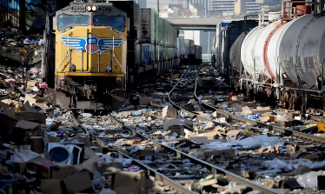
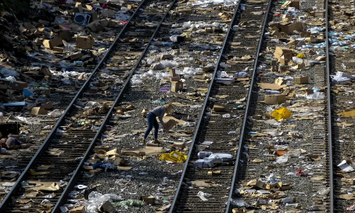
Business Problem
Union Pacific faced $5 Million in losses throughout the COVID-19 Pandemic
160% Jump in criminal rail theft in Los Angeles
Need for a more efficient and affordable way to track assets along the supply chain.
Our Team has developed a solution to prevent supply chain theft using the Helium blockchain.

Slide 3
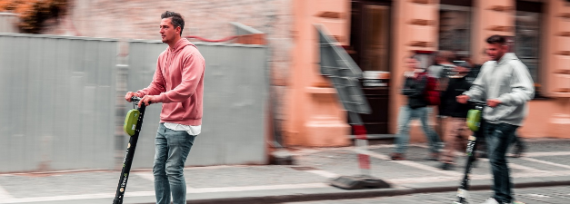
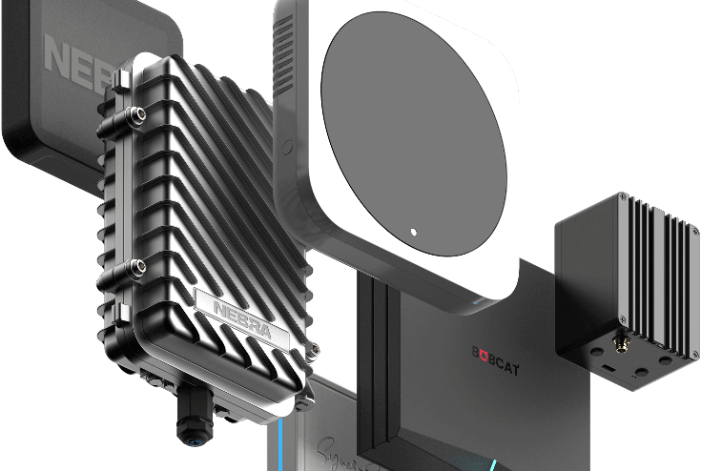
What is Helium?
Decentralized wireless network for IoT Devices.
Capable of Geolocation and long-range data transmission
Devices maintain connectivity without expensive cellular plans.
$.00001 - One Thousandth of a Cent - for every 24 bytes of data sent.
Low power – devices can last for years on battery
LoRaWAN - reaches 200 times farther than traditional Wi-Fi.
Miners participate to provide coverage

Slide 4
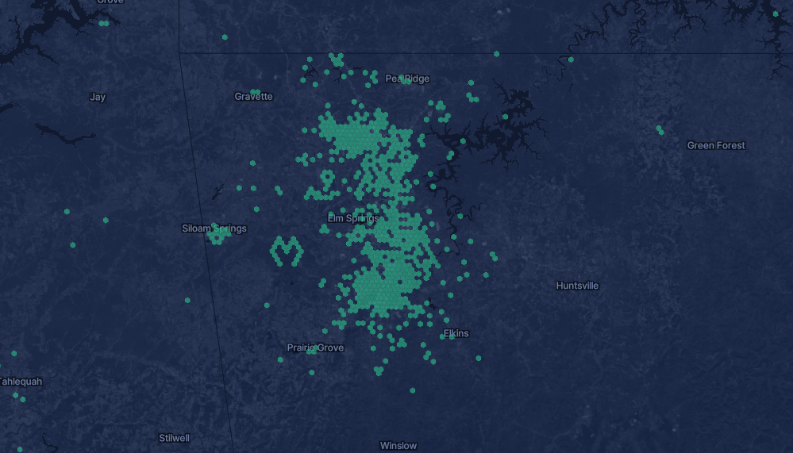

Slide 5
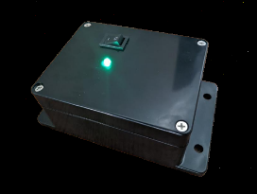
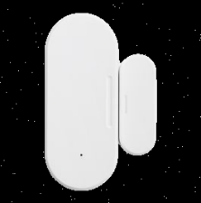
Solution
Geolocation tracking for assets of all types
Enables both small and large businesses to take control of their supply chain traceability.
Could also monitor the environment including temperature & humidity.
Door open/close sensor capable

Slide 6
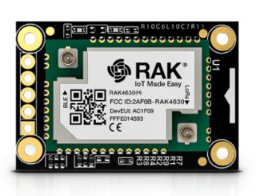
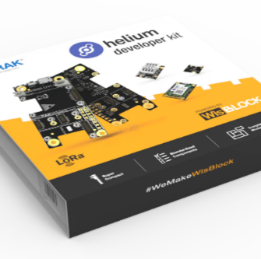
Hardware for Hackathon
Core is RAK4631
32 bit Cortex CPU
64MHz clock speed
256KB RAM / 1MB Flash
Mycelium Networks provided dev kits, sample code and support
RAK WisBlock – Micro-controller with sensor building blocks
Arduino IDE based environment

Slide 7
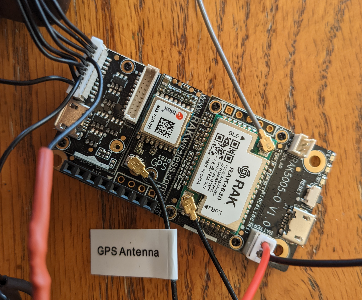
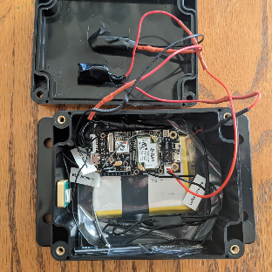
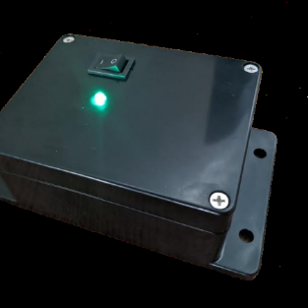
RazorBlock's constructed POC device
10s GPS timer
Device - $78.43
100,000 positions = 1 cent!
A total of 2694 packets transferred in testing phase. Entire cost = .02694 cents.

Slide 8
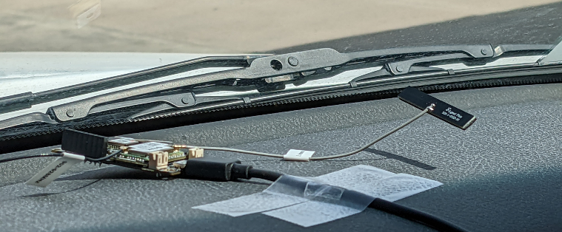
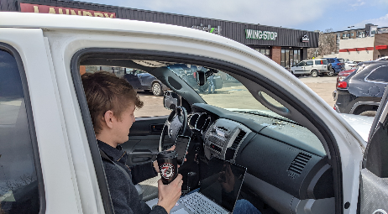
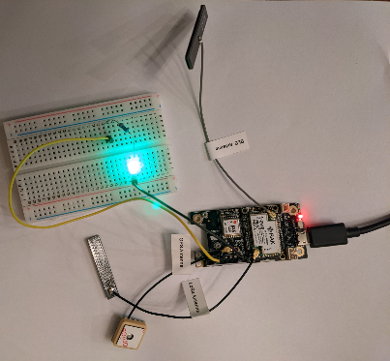
Testing

Slide 9
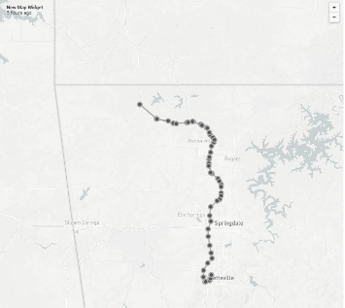
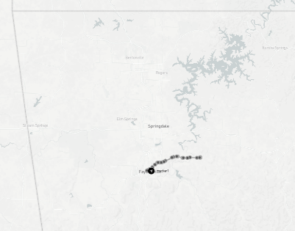
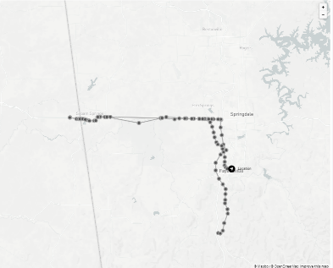
Rogers Test
Goshen Test
Siloam Springs/West Fork test
The Helium infrastructure in Northwest Arkansas provides sufficient coverage to support local supply chain tracking solutions.

Slide 10
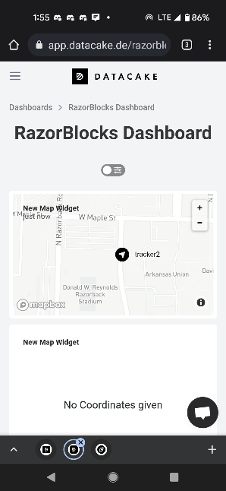

Data Interface
DataCakes – Commerical IoT platform
Free or low-cost monthly plans
Web based
Access on mobile device or desktop
Real-time map of device position
Houses historical data for reports

Slide 11
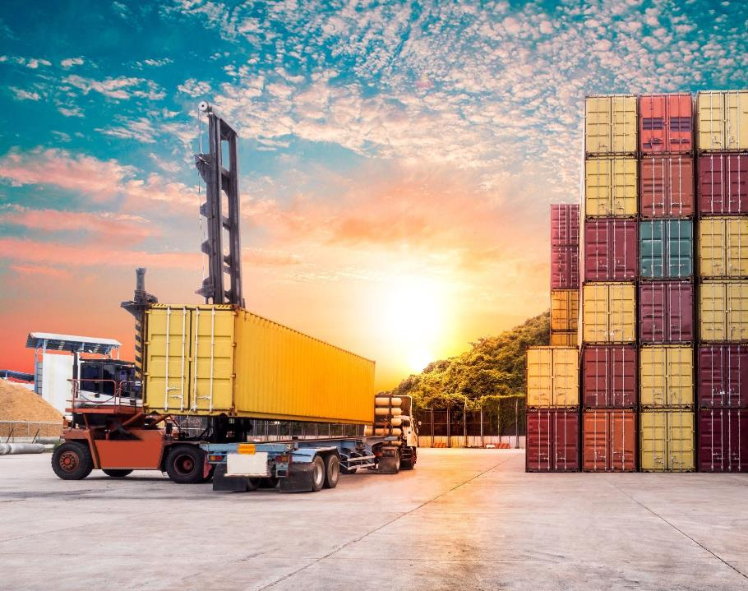
Other Applications
Rental car tracking
Cargo Container tracking
Pharmaceutical Tracking
Personal Asset Tracking
Car, Bike, Keys, Dog

Slide 12
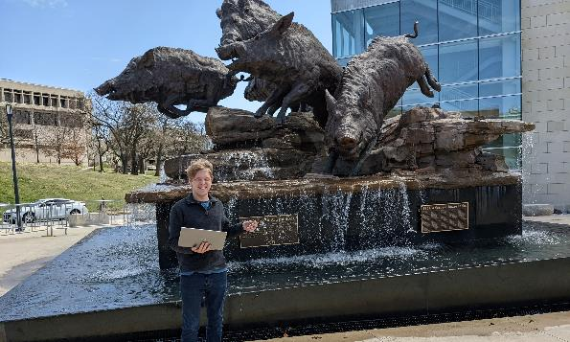

Conclusion
Develop more tracking solutions
Build IoT solutions outside of asset tracking air quality, soil quality, water quality etc.
Reduce Hardware Costs
Help NWA adopt and implement these emerging technologies

